Slide 1



Employee Churn
Analysis
Presented by : Khalid OUHMAID
Supervised by: Prof. Abdessamad Youssfi Alaoui

Slide 2
Problem Definition
Find out who of your employees is leaving the company and why
Employee turn-over (also known as “employee churn”) is a costly problem for companies
Employee churn analysis aims to predict who will leave the company
Binary Classification
Notes:
First things first, let’s perform some data visualization and preprocessing before jumping straight into building the model . This part is crucial, since we need to know what type of features we are dealing with

Slide 3
Plan :
-Problem Definition
-Tools used for building the project
-Data vizualisation and preprocessing
-Training the models:
+ logistic regression model
+ ANN model

Slide 4






Tools used for building the project

Slide 5
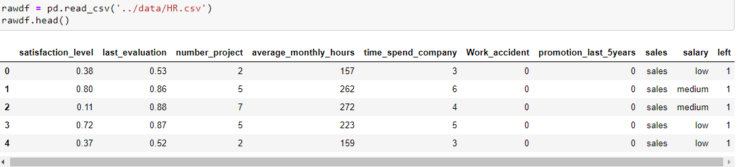
Data Visualization & Preprocessing
I used the Human Resources Analytics dataset on Kaggle
The dataset has around 15,000 rows and 9 columns.
The column we’re trying to predict is called “left”. It’s a binary column with 0/1 values.
The label 1 means that the employee has left.
Binary Classification

Slide 6

76% percent of the examples are labeled as 0, meaning the employee didn’t leave.
Notes:
The jupyter notebook contains the detailed analysis OF THE DATA. In summary, there are both real and categorical features. There are no null values, but some features need normalization. 76% percent of the examples are labeled as 0, meaning the employee didn’t leave.

Slide 7
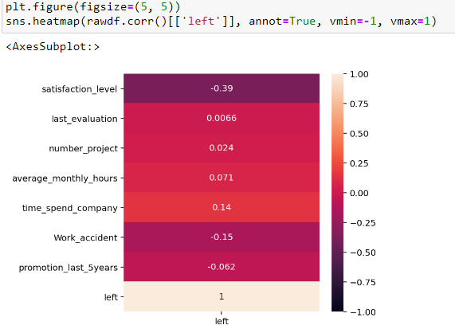
Correlation of the features with the label “left”
“left” has perfect correlation with “satisfaction_level”
Notes:
Let’s check the correlation of the features with the labels (the column named “left”). We will use the seaborn package for the correlation plot.
In this plot, positive values represent correlation and negative values represent inverse correlation with the label. Of course “left” has perfect correlation with itself, you can ignore that. Other than that only one feature has a strong signal, which is the “satisfaction_level”, inversely correlated with whether the employee has left. Which makes sense.

Slide 8
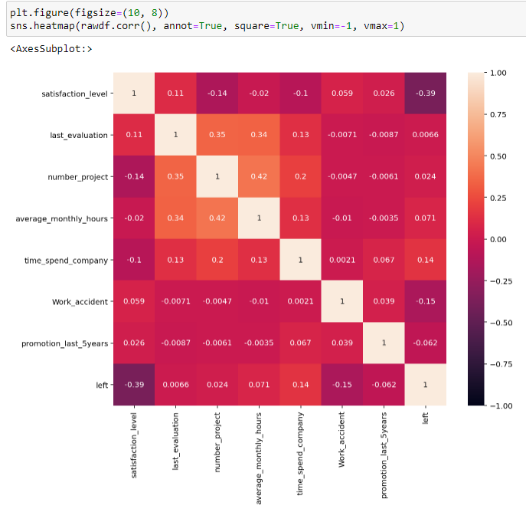
“average_monthly_hours” is positively correlated with “number_project”
Notes:
Now let’s look at the pairwise correlation of all features with one another.
We see that “average_monthly_hours” is positively correlated with “number_project”, which again makes sense. The more projects a person is involved with, the more hours of work they need to put in.

Slide 9
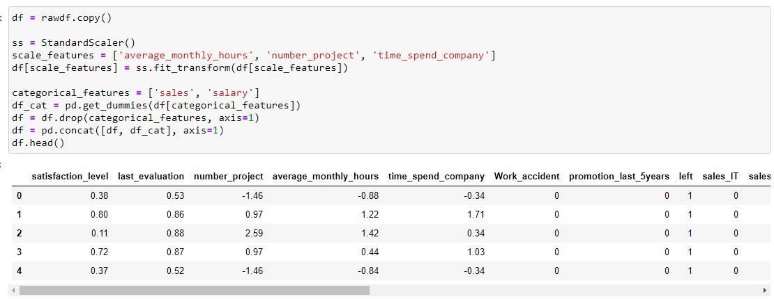
Data Normalisation

Slide 10
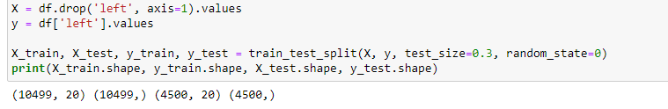
Creating the training and test data
Notes:
the final part is creating the training and test data. The model will perform learning on the training set and be evaluated on the held-out test set. Scikit-learn has a convenient train_test_split function. We only need to specify the fraction of the test set, in our case 30%. But first we convert our data from pandas dataframe to numpy array using the values attribute of the dataframe.

Slide 11
Training the model

Slide 12
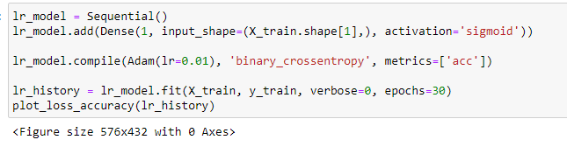
Logistic Regression Model
The Sequential model allows us to build deep neural networks by stacking layers one on top of another
The LR model has the form y=f(xW) where f is the sigmoid function. Having a single output layer being
directly connected to the input reflects this function.
The Dense function in Keras constructs a fully connected neural network layer
optimizer: Which optimizer to use in order to minimize the loss function.
loss: The loss function to minimize.
metrics: Which metric to report statistics on
Notes:
Now that we’re done with the data preprocessing and train/test set generation, here comes the fun part, training the model. We first start with a simple model, Logistic Regression (LR). We will then train a deep ANN and compare the results to LR.
We will use the Sequential model API . The Sequential model allows us to build deep neural networks by stacking layers one on top of another. Since we’re now building a simple logistic regression model, we will have the input nodes directly connected to output node, without any hidden layers. Note that the LR model has the form y=f(xW) where f is the sigmoid function. Having a single output layer being directly connected to the input reflects this function.
The first argument of dence function, represents number of nodes in this layer. input_shape: The first layer in Keras models need to specify the input dimensions . activation: The activation function of a logistic regression model is the logistic function, or alternatively called the sigmoid.
We then compile the model with the compile function. This creates the neural network model by specifying the details of the learning process.
optimizer: Which optimizer to use in order to minimize the loss function. There are a lot of different optimizers, most of them based on gradient descent. We will explore different optimizers in another tutorial. For now we will use the adam optimizer, which is the one people prefer to use by default.
loss: The loss function to minimize. Since we’re building a binary 0/1 classifier, the loss function to minimize is binary_crossentropy. We will see other examples of loss functions in later sections.
metrics: Which metric to report statistics on, for classification problems we set this as accuracy.

Slide 13
x: The input data, we defined it as X above. It contains the x and y coordinates of the input points
y: Not to be confused with the y coordinate of the input points. In all ML tutorials y refers to the labels, in our case the class we’re trying to predict: 0 or 1.
verbose: Prints out the loss and accuracy, set it to 1 to see the output.
epochs: Number of times to go over the entire training data. When training models
we pass through the training data not just once but multiple times.
Notes:
training the model using the fit function. The arguments are as follows:

Slide 14
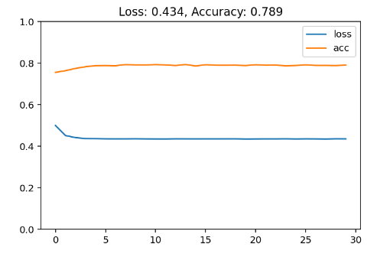
Notes:
The output of the fit method is the loss and accuracy at every epoch. We then plot it using our custom function,
We get 79% training accuracy. This is actually pretty bad, because above we saw that 76% of the labels were 0. So the most naive classifier which always outputs 0 regardless of the input would get 76% accuracy, and we’re not doing much better than that. This means our data is not linearly separable, we need a more complex model.

Slide 15
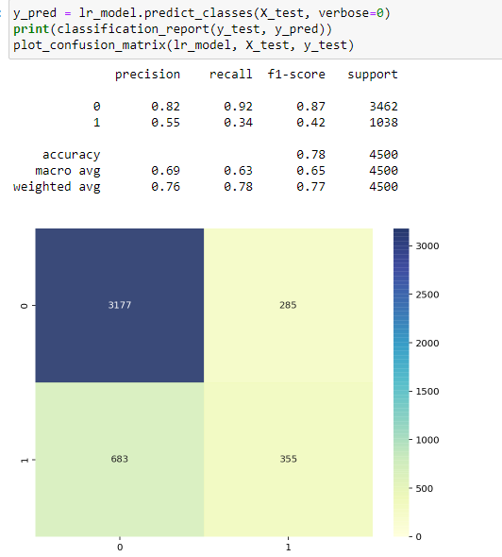
Test accuracy is 78%
Notes:
the chart depicts the training loss and accuracy. But more importantly we’re interested in the metrics of the test set. Metrics in the training set might be misleading since the model is already trained on it, we want to check how the model performs on an held-out test set. Test accuracy is 78%, slightly lower than training accuracy. Test accuracy of ML models are almost always less than training, because the test data is unseen to the model during the training process. Looking at the classification report, we see that only 60% of the examples belonging to class 1 are classified correctly. Pretty bad performance. The confusion matrix also doesn’t look promising showing a lot of misclassified examples.

Slide 16
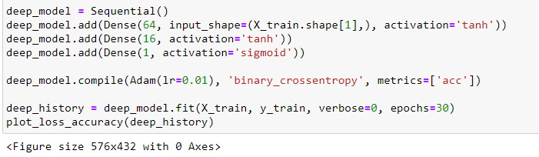
Artificial neural Model
We have 2 hidden layers with 64 and 16 nodes with tanh activation function. The output layer uses the sigmoid activation
We use the Adam optimizer with learning rate set to 0.01
Notes:
Now let’s another model which is deep neural network for binary classification. This model is much more powerful, and will be able to model non-linear relationships
The model building process is again very familiar. We have 2 hidden layers with 64 and 16 nodes with tanh activation function. The output layer uses the sigmoid activation since it’s a binary classification problem. We use the Adam optimizer with learning rate set to 0.01.

Slide 17
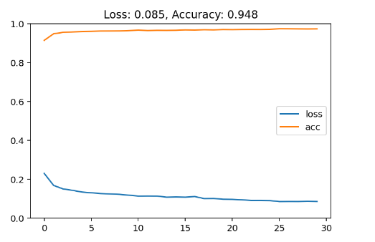
This time we achieve 94.8% training accuracy, pretty good.

Slide 18
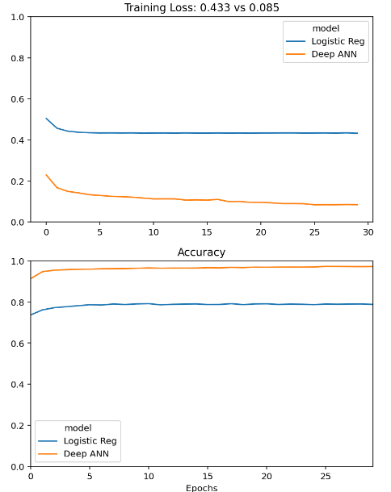
Comparison of the LR and ANN models
The ANN model is much superior,
having a lower loss and a higher accuracy

Slide 19
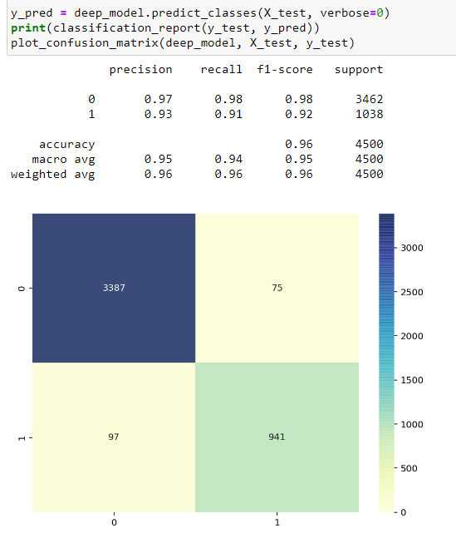
We achieve 97% accuracy, compared to 78% of the LR model
We still misclassify 147 examples out of 4500
Notes:
And for completeness here’s the classification report and confusion matrix of the ANN model on the test set. We achieve 97% accuracy, compared to 78% of the LR model. We still misclassify 147 examples out of 4500.

Slide 20
We can further improve the performance of the ANN by doing the following:
Train the model for longer (increase the number of epochs).
Hyperparamter tuning: change the learning rate, use a different optimizer than Adam (RMSprop for example), use another activation function than tanh (can be relu).
Increase the number of nodes per layer: Instead of 64–16–1 we can do 128–64–1.
Increase the number of layers: We can do 128–64–32–16–1.
Notes:
One important caveat though, as we make the model more powerful, the training loss will likely decrease and accuracy will increase. But we will run into the risk of overfitting. Meaning the complex model will perform worse on the test set compared to a simpler model, even though the training metrics of the complex model is better

Slide 21
The simplest model that gets the job done is sufficient.
Notes:
is very important to keep in mind. That’s why we don’t go crazy with number of layers and nodes per layer. The simplest model that gets the job done is sufficient.

